Slide 1

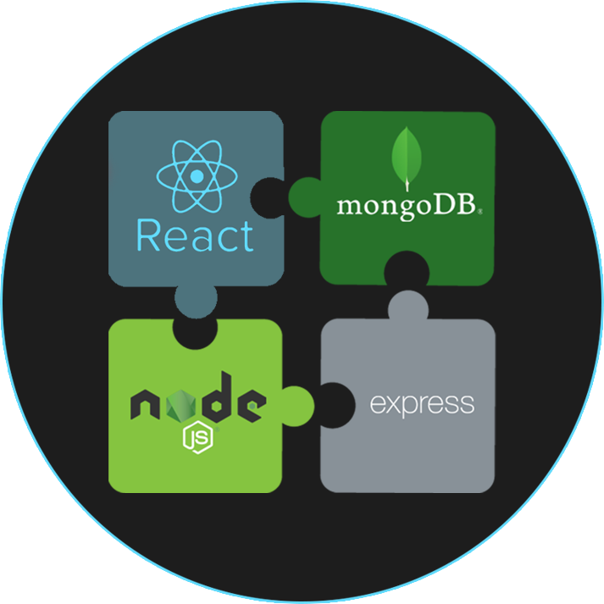
MERN Stack Front To Back
Before We Begin

Slide 2
Project Files
Full Project will be on GitHub
https://github.com/bradtraversy/devconnector
The last video in each section will include the code for that section

Slide 3
If You Get Stuck
Do your best to search for the answer on your own
If needed, post to the Q&A area
Include the issue with your code
If I cannot help from that I may ask you to email me your code
If I do not get to your question, please do not get upset, I get hundreds of questions everyday which are impossible to manage

Slide 4
Bugs & Issues
This is not a production application built by a team
There is a chance you may find a bug or two
Post bugs and fixes in the Q&A
I will try to address and either document or re-record
There also may be new content/functionality added in the future

Slide 5


FOLLOW BRAD:
Youtube.com/c/traversymedia
Facebook.com/traversymedia
Twitter.com/traversymedia
Linkedin.com/in/bradtraversy
Thank You
For Watching!
www.traversymedia.com

